Slide 1

Project Title: Network Port Scanner with Graphic User Interface
Name - Prajan Kannan
AICTE ID - STU66ee8be6e60f11726909414
College Name – Vellore Institute of Technology, Chennai

Slide 2

PROBLEM STATEMENT
Modern networks are vulnerable to unauthorized access due to open and unmonitored ports, making it difficult to identify potential security risks efficiently.
This project aims to develop an automated and user-friendly network port scanner to detect open ports and enhance network security assessment.

Slide 3
Project Description
This project focuses on the design and development of a TCP-based network port scanner with an intuitive graphical user interface using Python and Tkinter.
The system performs automated scanning of a specified range of ports on a target host to identify open and potentially vulnerable communication endpoints.
It incorporates multi-threading techniques to significantly enhance scanning speed and efficiency, enabling concurrent port analysis.
The application includes service identification mechanisms, mapping common port numbers to standard network services such as HTTP, FTP, and SSH.
A real-time monitoring interface is implemented, providing live progress updates, scan status, and elapsed time for improved user interaction.
The tool supports result visualization and export functionality, allowing users to save detected open ports for further security analysis and reporting.

Slide 4

WHO ARE THE END USERS?
Network Administrators – Monitor and manage network security by identifying open ports and unauthorized services.
Cybersecurity Professionals / Ethical Hackers – Perform vulnerability assessment and penetration testing to secure systems.
System Administrators – Ensure proper configuration of servers and detect unnecessary open ports.
IT Support Teams – Troubleshoot network connectivity issues and service availability.
Students & Researchers – Learn networking concepts, port communication, and security practices.
Organizations / Enterprises – Protect internal networks from external threats and maintain secure infrastructure.
Developers – Test applications and verify whether required ports/services are running correctly.

Slide 5
Technology & Tools Used
Python (Core Language) Used to implement the complete application logic including networking, threading, and GUI development.
Tkinter (GUI Framework) Provides the graphical user interface components such as input fields, buttons, progress bar, and result display using Treeview.
Socket Programming (socket module) Enables TCP-based communication to scan and detect open ports on the target system.
Multithreading (threading module) Used to perform concurrent port scanning, improving speed and efficiency by handling multiple ports simultaneously.
Queue (queue module) Ensures thread-safe communication between background scanning threads and the GUI for real-time updates.
Time & Date Handling (time, datetime modules) Used for tracking scan duration, timestamps, and logging scan activities.
File Handling (built-in I/O) Enables saving scan results into .txt or .csv files for further analysis.
Development Tools – VS Code / PyCharm Used for coding, debugging, and testing the application.
Version Control – Git & GitHub Used to manage source code, track changes, and host the project repository.

Slide 6
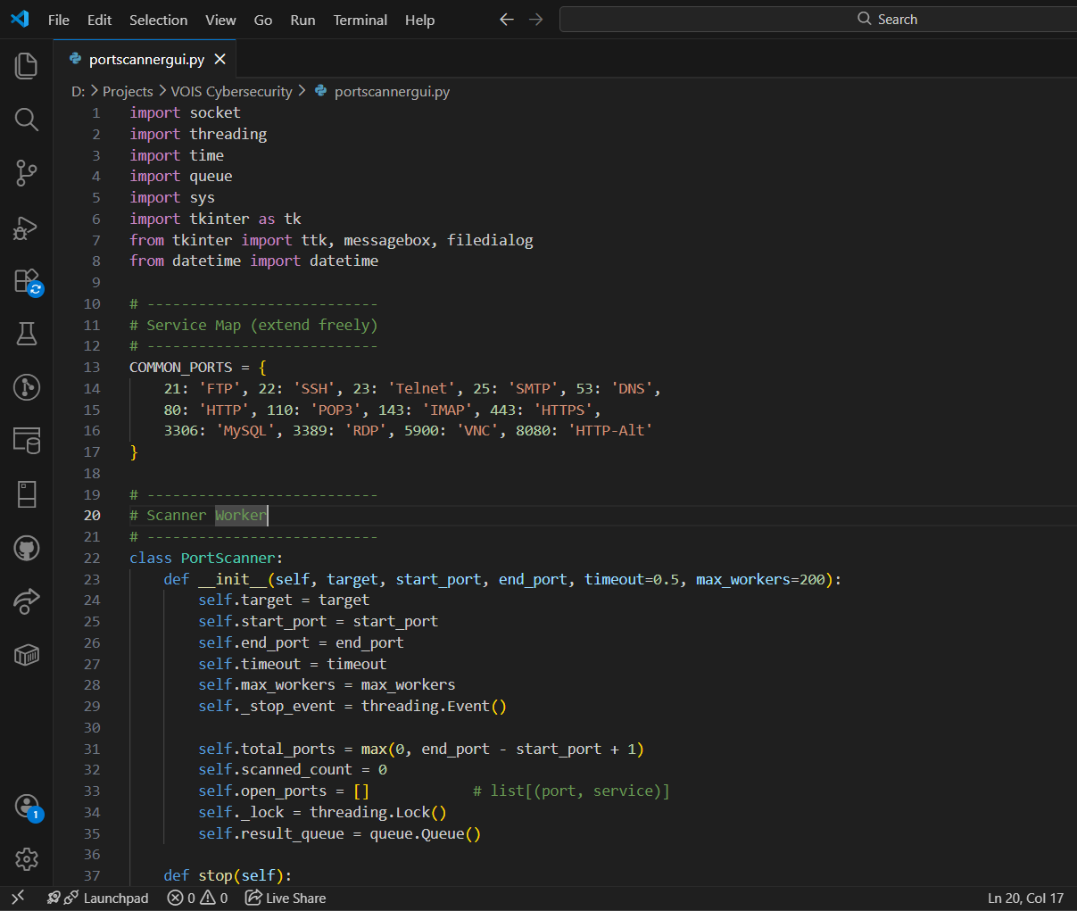
RESULTS

Slide 7
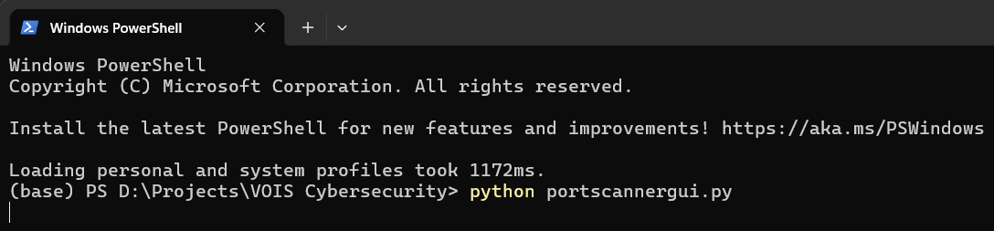
RESULTS

Slide 8
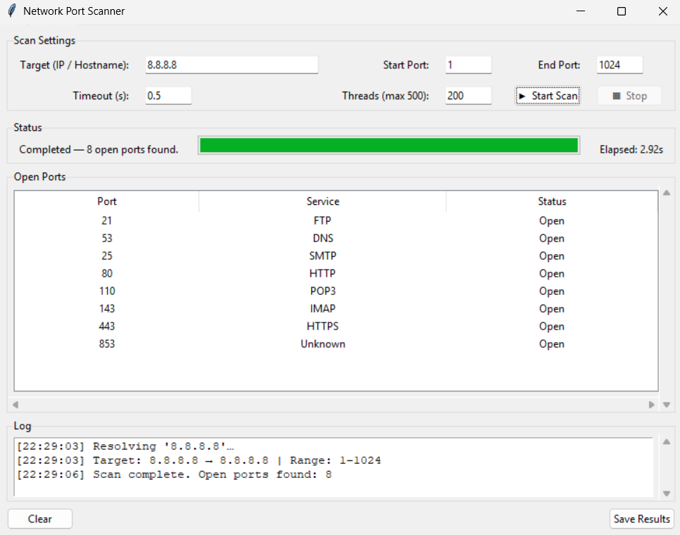
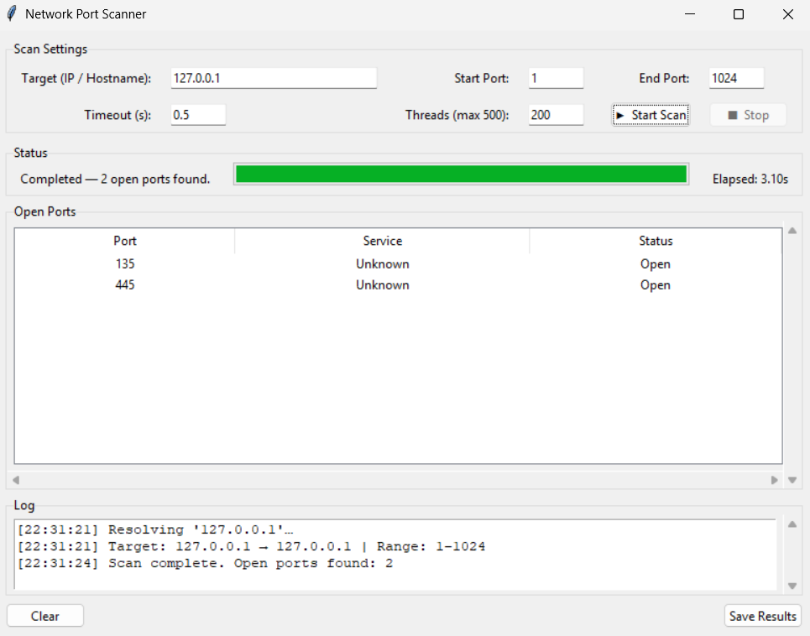
RESULTS

Slide 9
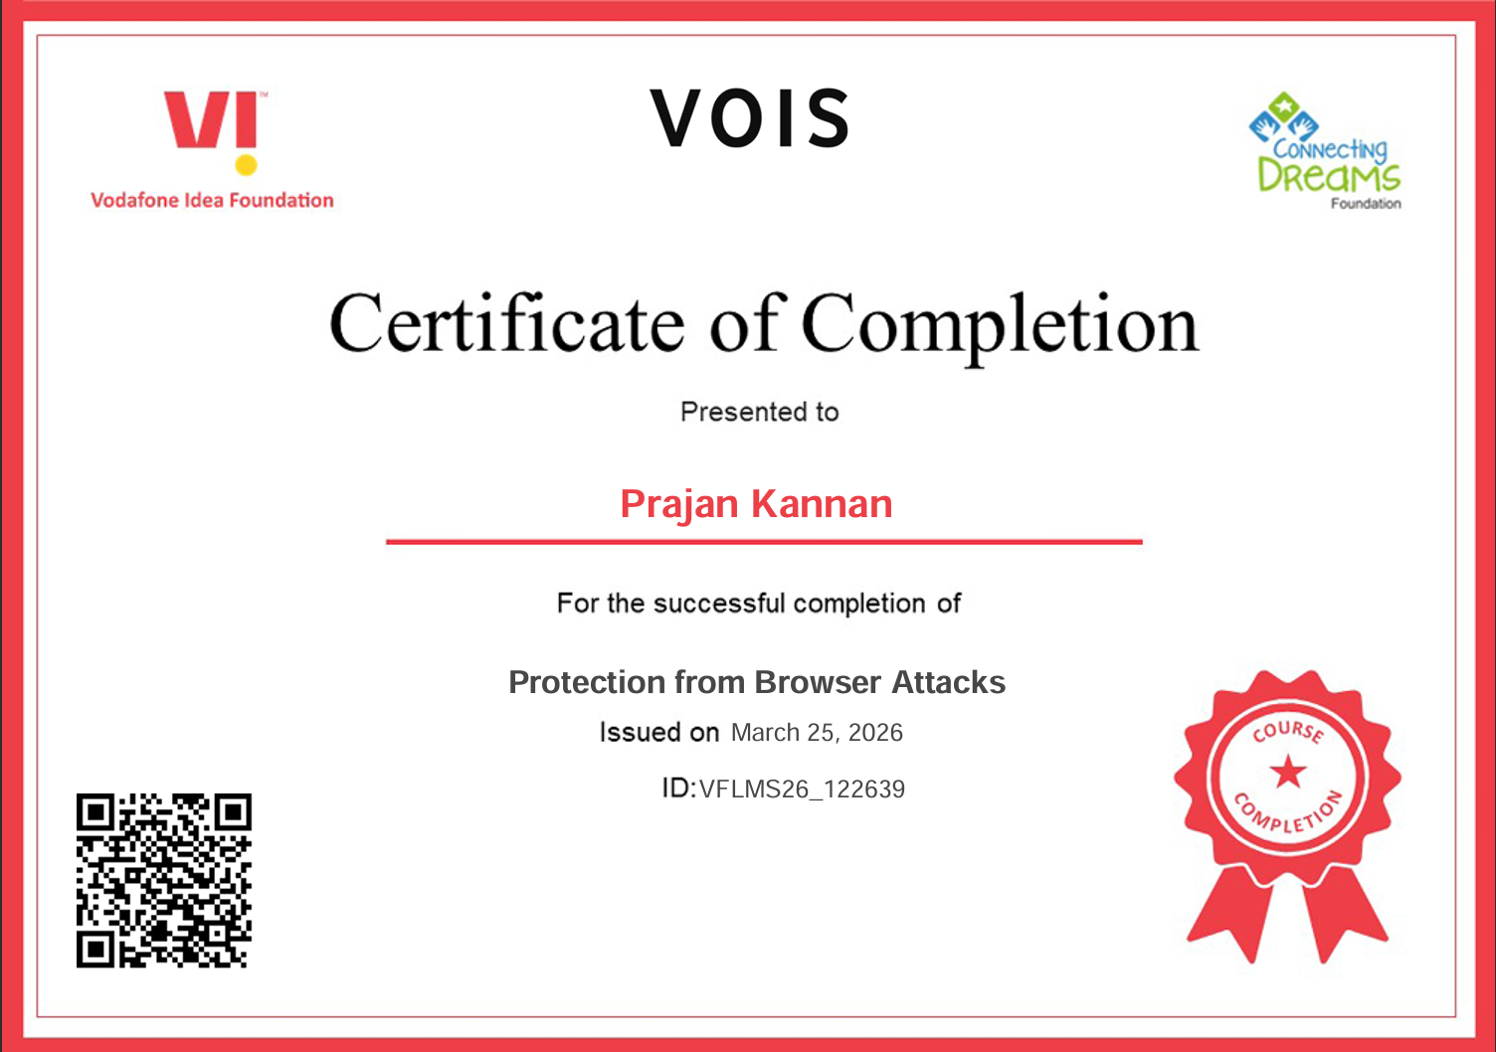
Certificate - Protection from browser attacks

Slide 10
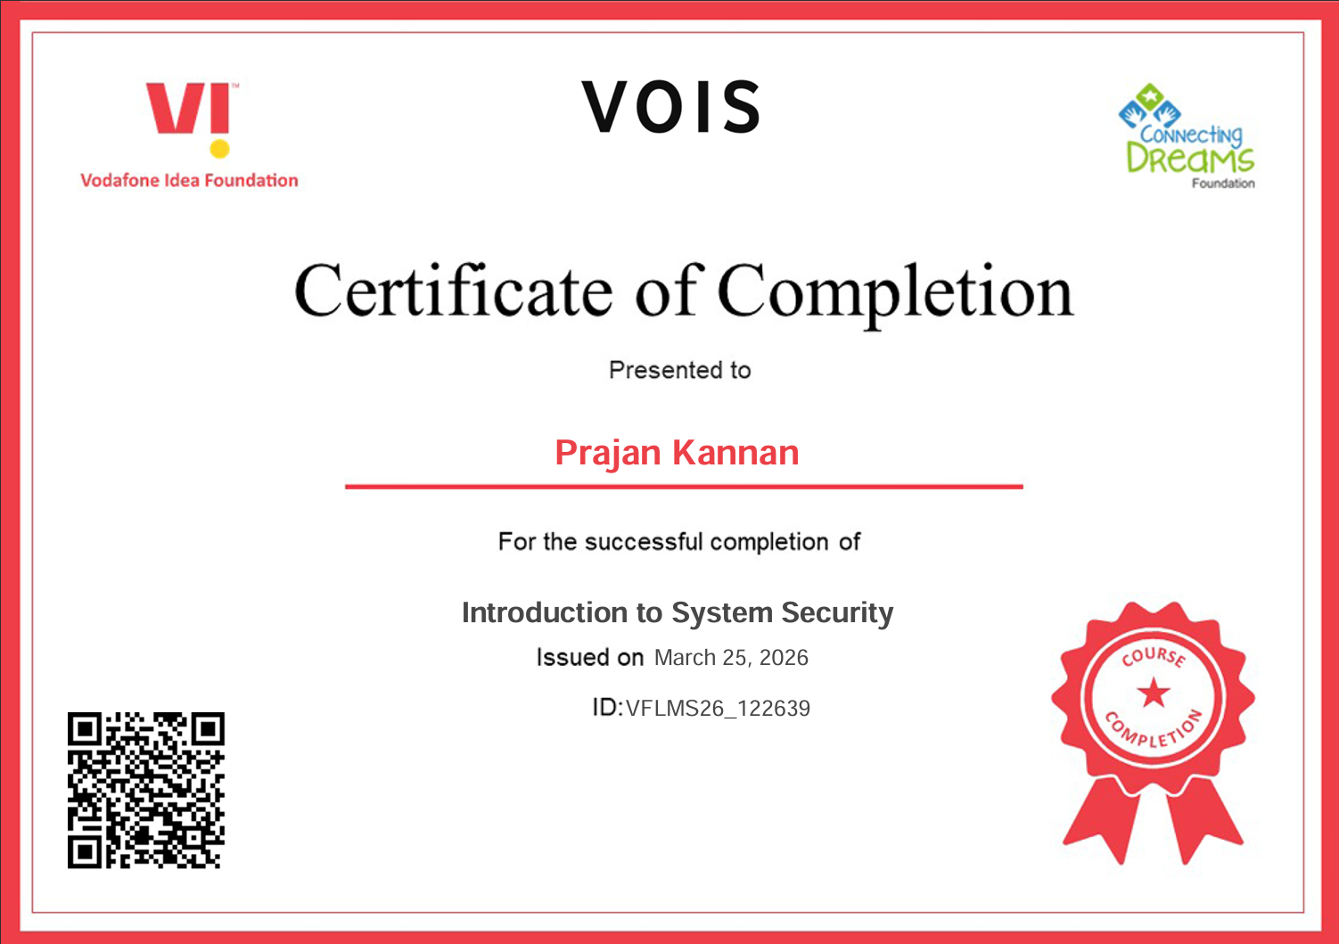
Certificate - Introduction to System Security

Slide 11
Thank you
Github Link : https://github.com/Prajan2910/GUI-for-Network-Port-Scanner
I sincerely thank everyone who supported and guided me throughout the development of this project “Network Port Scanner”, contributing to its successful completion.
I am grateful for the opportunity to learn and apply my knowledge in Cybersecurity.
.
.

